Slide 1

AI-Based Personal Finance Manager with Smart Expense Prediction System
by
S. HEMANTH KUMAR
Roll No. 224G1A0528
B. JAHNAV ARJUN GOWD
Roll No. 224G1A0532
T. PAVAN
Roll No. 224G1A0567
Under the guidance of
Mr. P. SHAJAHAN, M.Tech. Assistant Professor
Department of Computer Science and Engineering
Srinivasa Ramanujan Institute of Technology
Autonomous
Rotarypuram Village, B K Samudram Mandal, Ananthapuramu – 515701.
Accredited by NBA & NAAC with “A” Grade, Affiliated to JNTUA, Ananthapuramu.
2025-2026
Srinivasa Ramanujan Institute of Technology

Slide 2
Queries From Review 0
AI-Based Personal Finance Manager with Smart Expense Prediction System
What is the main objective of this project?
How does the system predict future expenses?
What type of users can use this application?
What services are provided by this application?
Srinivasa Ramanujan Institute of Technology

Slide 3
Title Explanation
AI-Based Personal Finance Manager with Smart Expense Prediction System
The title “AI-Based Personal Finance Manager with Smart Expense Prediction System” represents a web-based application designed to manage personal finances efficiently using artificial intelligence and machine learning.
AI-Based refers to the use of Artificial Intelligence and Machine Learning techniques to analyze user financial data, identify spending patterns, and provide intelligent predictions and insights.
Personal Finance Manager refers to a digital platform that helps users track expenses, manage budgets, monitor savings goals, analyze spending patterns, and generate financial reports in an organized manner.
Smart Expense Prediction System means the system predicts future expense amounts based on historical spending behavior, budget limits, and usage patterns, helping users plan finances and avoid overspending.
Srinivasa Ramanujan Institute of Technology

Slide 4
Contents
AI-Based Personal Finance Manager with Smart Expense Prediction System
Abstract
Introduction
Software Requirements
Datasets/Modules
Implementation
Outputs
Conclusion
References
Srinivasa Ramanujan Institute of Technology

Slide 5
Abstract
AI-Based Personal Finance Manager with Smart Expense Prediction System
This project develops an AI-Based Personal Finance Manager to help users analyze expenses, manage budgets, and track savings using intelligent financial analytics.
Existing personal finance applications mainly record past expenses and do not provide intelligent expense analysis, future spending prediction, or proactive financial insights.
The system uses machine learning regression techniques to analyze historical expense data along with user budget information and spending patterns to predict future expenses.
The application provides predicted expense values, budget usage analysis, and alert notifications that help users control overspending and plan finances effectively.
By integrating expense analysis with AI-based prediction, the system supports smarter financial decision-making and improves overall personal money management.
Srinivasa Ramanujan Institute of Technology

Slide 6
Introduction
AI-Based Personal Finance Manager with Smart Expense Prediction System
This project is designed to develop an AI-Based Personal Finance Manager with Smart Expense Prediction System for analyzing and managing personal expenses.
It allows users to record daily expenses, categorize spending, set budgets, and track savings goals digitally.
The system analyzes user spending patterns and provides insights to control overspending and manage finances effectively.
Using machine learning techniques, the application predicts future expenses based on historical spending behavior.
The project provides a centralized and intelligent platform to support better financial planning and decision-making.
Srinivasa Ramanujan Institute of Technology

Slide 7
AI-Based Personal Finance Manager with Smart Expense Prediction System
Software Requirements
Frontend → HTML, CSS, JavaScript → Bootstrap
Backend → Python → Django Framework
Database → SQLite
AI / Logic → Machine Learning (Regression Models)
Tools → Visual Studio Code
Srinivasa Ramanujan Institute of Technology

Slide 8
Datasets/Modules
AI-Based Personal Finance Manager with Smart Expense Prediction System
User Expense Dataset
Fields: Expense ID, User ID, Expense Category, Amount, Date, Month, Payment Mode, Description
Purpose: Stores user expense records and serves as the primary dataset for expense tracking and analysis.
Budget Dataset
Fields: Budget ID, User ID, Category, Monthly Budget Limit, Spent Amount, Remaining Amount
Purpose: Maintains budget details and supports budget monitoring and alert generation.
Expense Prediction Dataset
Fields: Record ID, User ID, Expense Category, Month, Payment Mode, Budget Limit, Historical Average, Predicted Amount
Purpose: Used to train and test Machine Learning models for predicting future expense amounts.
Srinivasa Ramanujan Institute of Technology

Slide 9
Datasets/Modules
AI-Based Personal Finance Manager with Smart Expense Prediction System
Savings Goal Dataset
Fields: Goal ID, User ID, Goal Name, Target Amount, Saved Amount, Deadline, Status
Purpose: Tracks user savings goals and monitors progress toward financial targets.
Group Dataset
Fields: Group ID, Group Name, Created By (User ID), Created Date
Purpose: Stores family or group details and supports shared expense management.
Srinivasa Ramanujan Institute of Technology

Slide 10
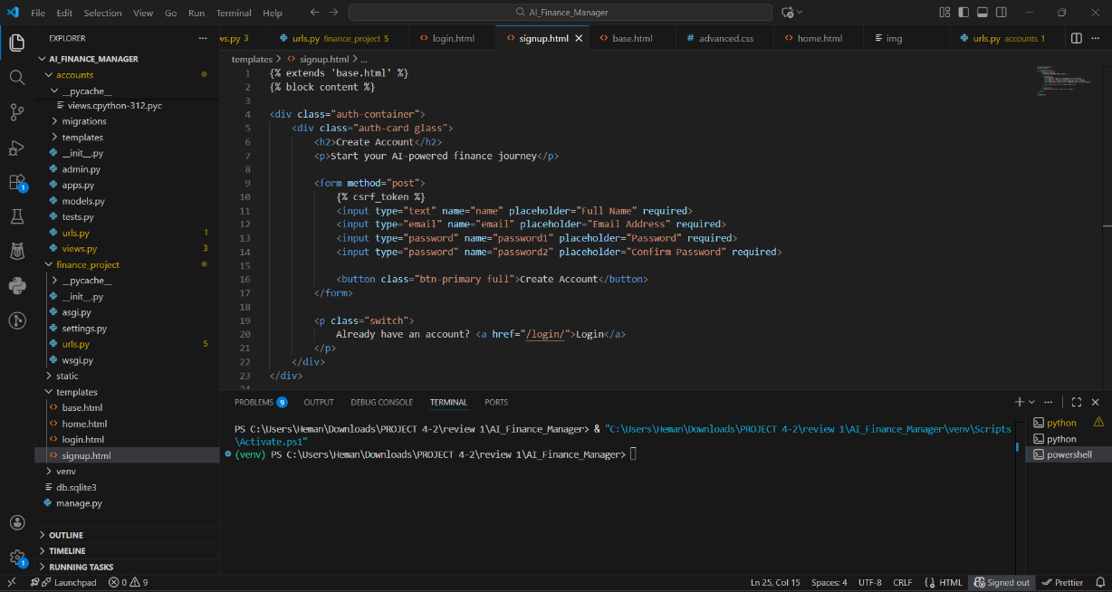
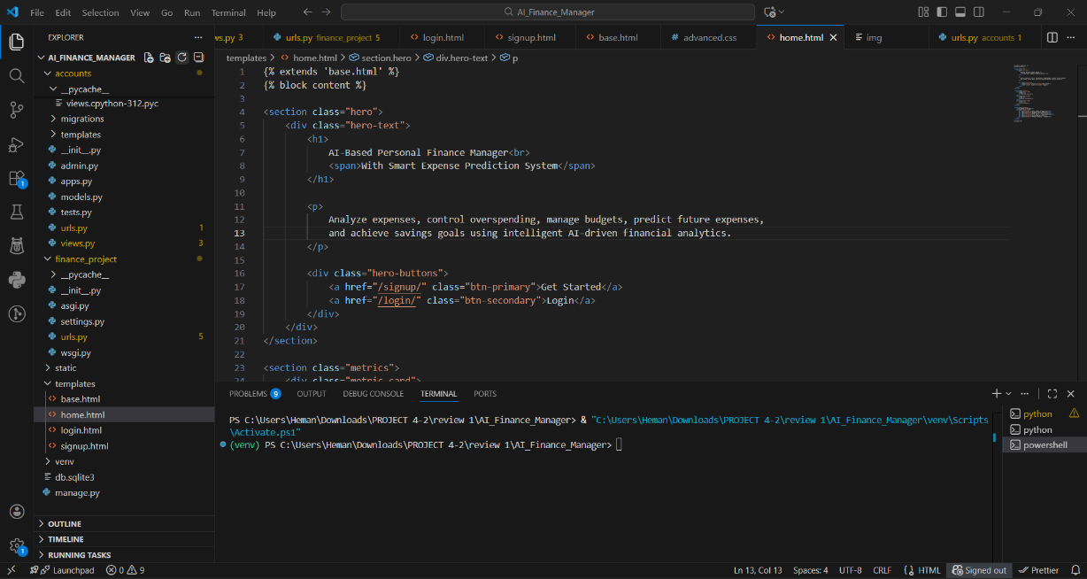
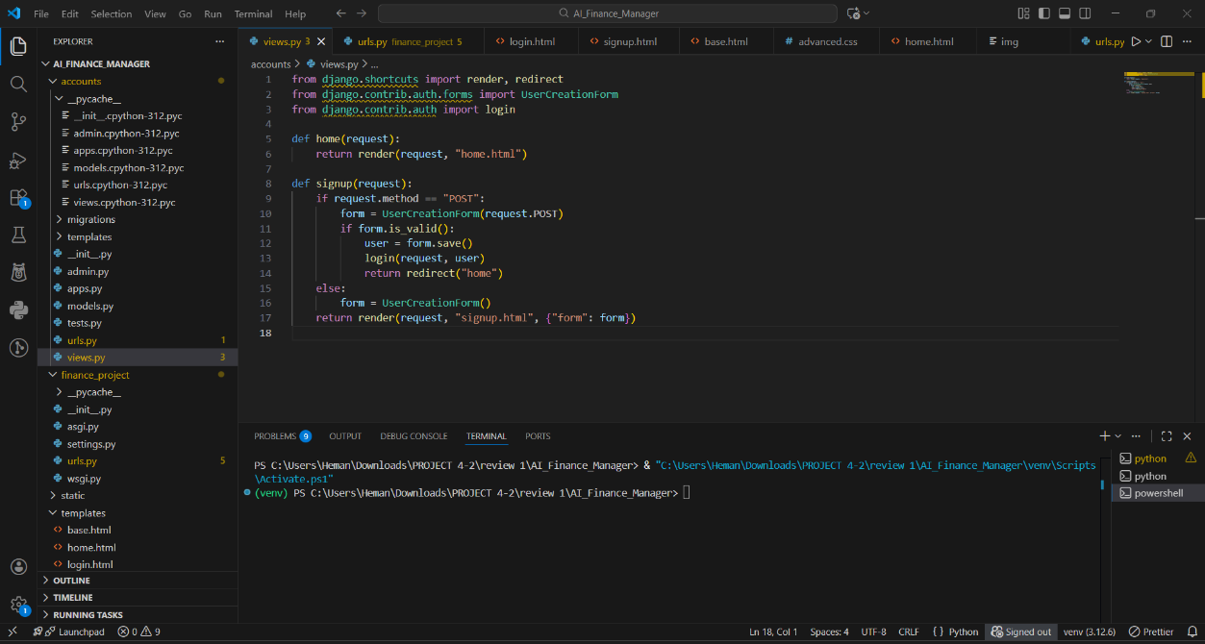
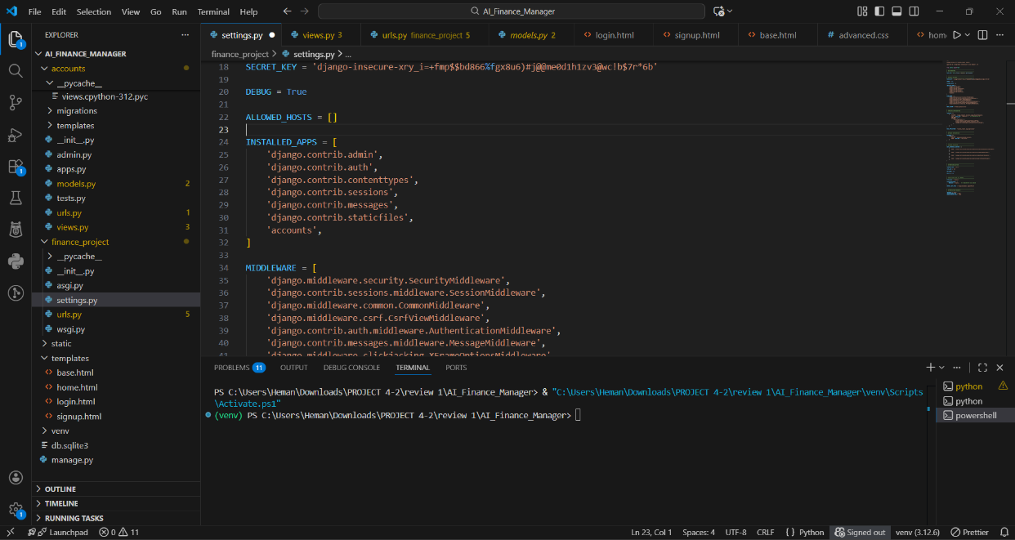
Implementation
AI-Based Personal Finance Manager with Smart Expense Prediction System
Srinivasa Ramanujan Institute of Technology

Slide 11
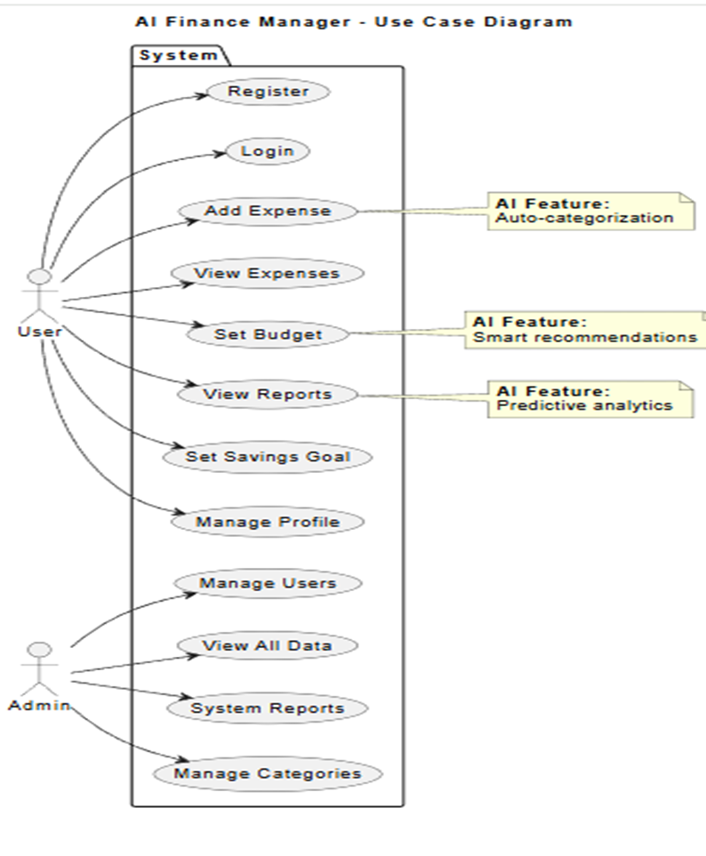
UML diagram of Use Case
AI-Based Personal Finance Manager with Smart Expense Prediction System
Purpose: Centralized platform to manage personal financial activities between Users and Admins using AI-based insights and expense prediction.
User Role:
Register and login to the system
Add and manage personal expenses
Set budgets and savings goals
View expense reports and financial insights
Receive AI-based expense predictions and recommendations
Admin Role:
Create a group (Family / Group Mode)
Add or remove members from the group
View all group members’ expenses
Track who spent on what within the group
Monitor total group spending and shared budgets
Srinivasa Ramanujan Institute of Technology

Slide 12
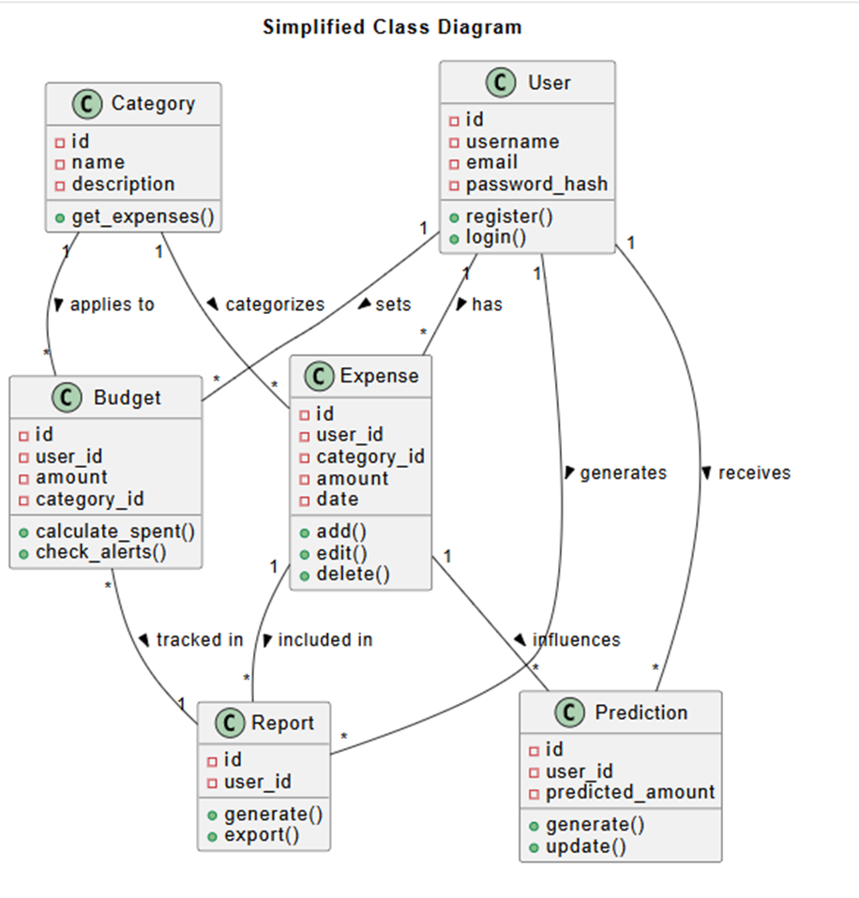
UML diagram of Class
AI-Based Personal Finance Manager with Smart Expense Prediction System
Purpose: To represent the static structure of the system showing classes, attributes, and methods.
User Class: Attributes: user_id, username, email, password.
Represents the individual using the system.
Group Class (Family Mode): Attributes: group_id, group_name, created_by.
Represents a family or shared expense group.
Expense Class:
Attributes: expense_id, user_id, group_id, category, amount, date.
Represents personal and group expenses.
Budget Class:
Attributes: budget_id, user_id, category, limit, spent_amount.
Used for tracking and controlling expenses.
Prediction Class:
Attributes: prediction_id, user_id, predicted_amount.
Represents the smart expense prediction output.
Srinivasa Ramanujan Institute of Technology

Slide 13
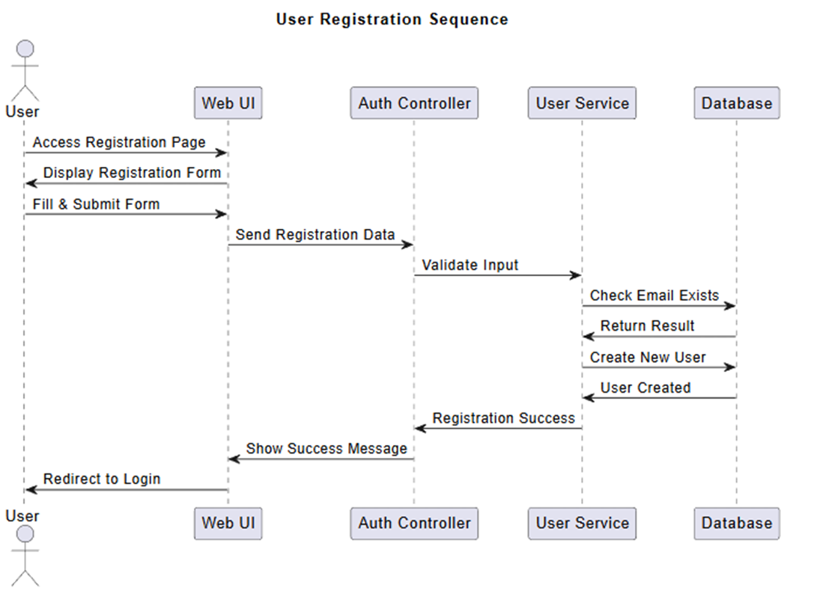
UML diagram of Sequence
AI-Based Personal Finance Manager with Smart Expense Prediction System
Purpose: To show the sequence of interactions between User and System over time in the AI-Based Personal Finance Manager.
System Sequence:
Expense data collection and Data preprocessing
Feature extraction for prediction
Machine Learning model execution
Expense amount prediction
User Sequence:
Register
Login
Add expense / provide input data
View predicted expense
Logout
Interaction Flow:
User initiates requests through the application
System processes expense data using ML techniques
Predicted expense result is generated and sent back to the user
Srinivasa Ramanujan Institute of Technology

Slide 14
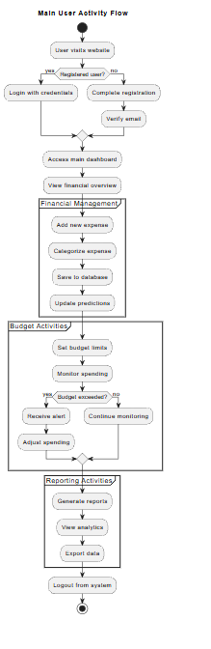
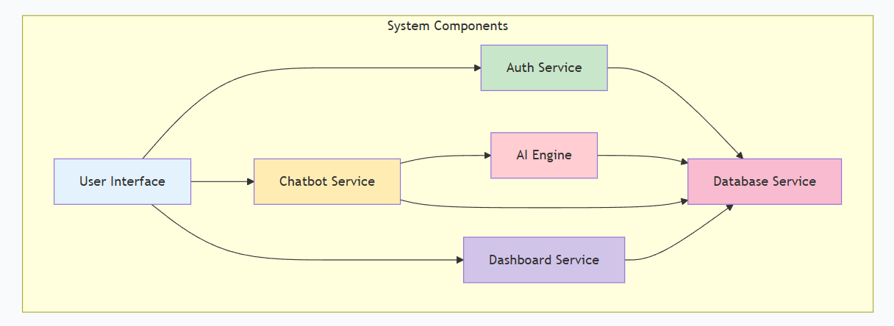
UML diagram of Activity & Component
AI-Based Personal Finance Manager with Smart Expense Prediction System
Activity Diagram
Shows the step-by-step flow of user actions in the AI-Based Personal Finance Manager.
Starts with user login or registration.
Includes adding expenses, categorizing spending, and updating predictions.
Covers budget monitoring and alert generation when limits are exceeded.
Ends with report generation and user logout.
Component Diagram
Shows the high-level system architecture of
the application.
Includes User Interface, Backend Server, AI Processing Module, and Database.
Represents interaction between frontend, AI services, and backend logic.
Helps understand system integration and data flow for expense prediction and management.
Srinivasa Ramanujan Institute of Technology

Slide 15
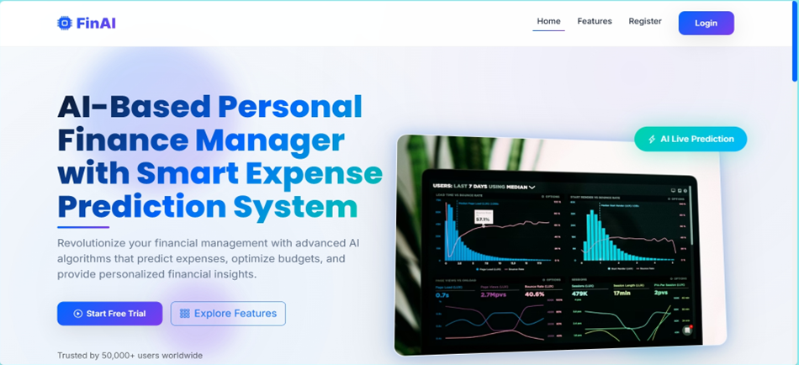
Outputs
AI-Based Personal Finance Manager with Smart Expense Prediction System
Srinivasa Ramanujan Institute of Technology

Slide 16
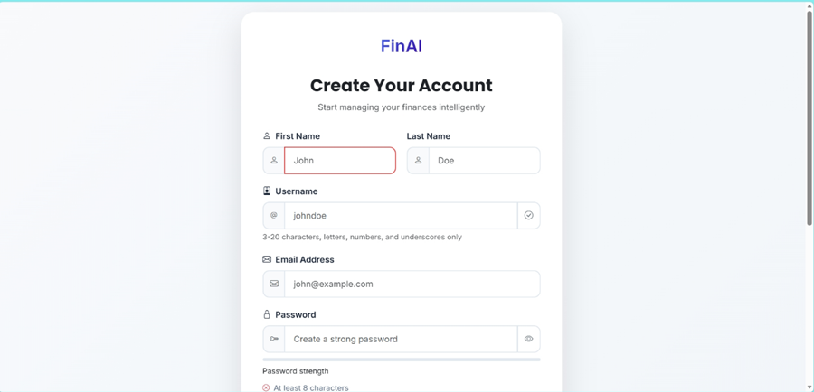
Outputs
AI-Based Personal Finance Manager with Smart Expense Prediction System
Srinivasa Ramanujan Institute of Technology

Slide 17
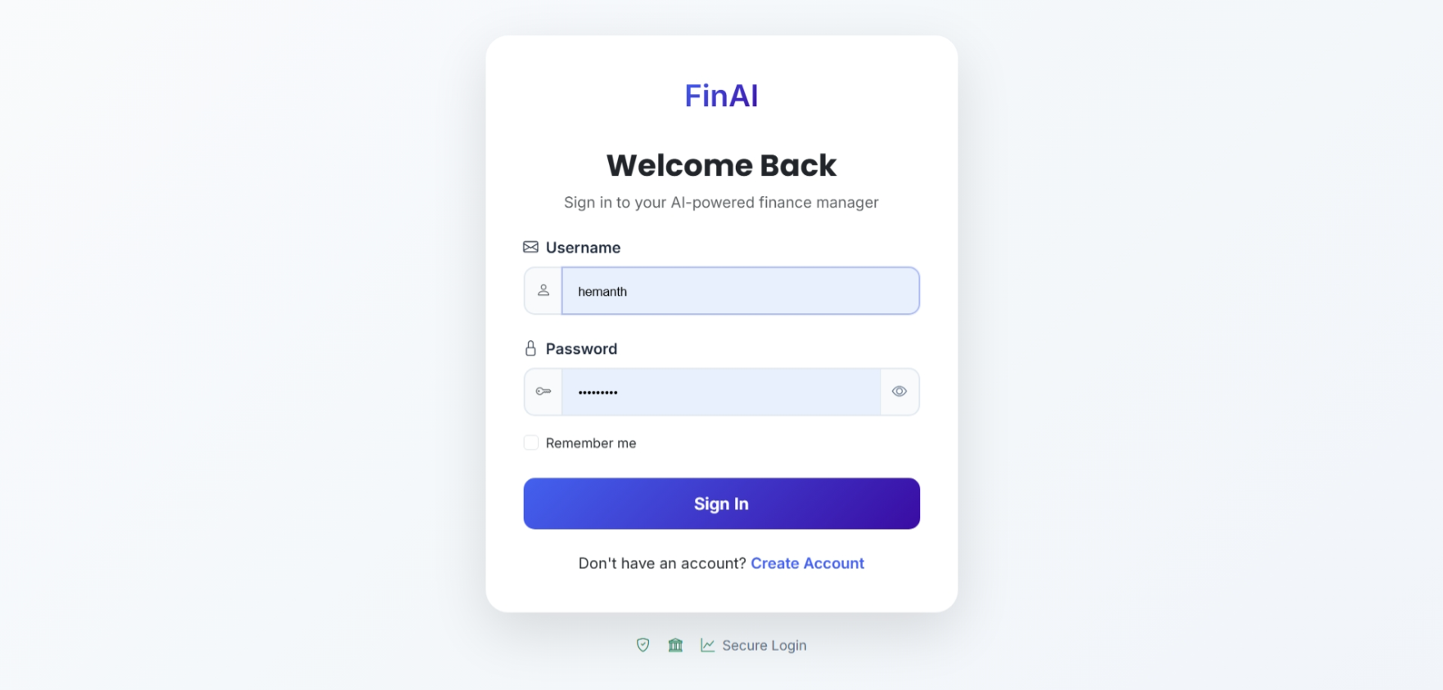
Outputs
AI-Based Personal Finance Manager with Smart Expense Prediction System
Srinivasa Ramanujan Institute of Technology

Slide 18
Conclusion
AI-Based Personal Finance Manager with Smart Expense Prediction System
The AI-Based Personal Finance Manager with Smart Expense Prediction System provides an effective platform for managing personal and group-based financial activities.
The system enables users to track expenses, manage budgets, monitor savings goals, and view financial reports through a user-friendly interface.
The integration of machine learning and a general AI chatbot supports smart expense prediction and better financial decision-making.
In the future, the system can be enhanced by integrating bank APIs, and improving prediction accuracy using advanced AI models.
Srinivasa Ramanujan Institute of Technology

Slide 19
References
AI-Based Personal Finance Manager with Smart Expense Prediction System
Books
[1] Ian Goodfellow, Yoshua Bengio, and Aaron Courville, Deep Learning. Cambridge, MA: MIT Press, 2016.
Journal Article
[2] L. Chen and R. Williams, “Machine Learning-Based Expense Prediction for Personal Finance Management,” International Journal of Data Science and Analytics, vol. 14, no. 2, pp. 85–97, March 2022.
Newspaper article
[3] “How Artificial Intelligence Is Transforming Personal Finance,” The Economic Times, vol. 183, pp. 12–13, June 10, 2023.
Technical Report
[4] Organisation for Economic Co-operation and Development (OECD), “Artificial Intelligence in Personal Financial Management and Consumer Decision-Making,” OECD Publishing, Financial Technology Technical Report OECD-AI-FIN-2021-07, July 2021.
Srinivasa Ramanujan Institute of Technology

Slide 20
Thank You!!!
AI-Based Personal Finance Manager with Smart Expense Prediction System
Srinivasa Ramanujan Institute of Technology

Slide 21
Any Queries?
AI-Based Personal Finance Manager with Smart Expense Prediction System
Srinivasa Ramanujan Institute of Technology

